Slide 1

Introduction - GeoGuessrAI
Train a model to be able to classify which country a given image is taken in
Why it will work
We have access to a lot of data – we can always scrape more.
Some people can make high precision guesses based on meta data for each country – so it should be possible to train a model to do the same.
Similar projects has shown decent results
Easily scalable – if it is too easy, we can add more countries, if it is too difficult, we can subset to choose countries which have very different characteristics

Slide 2
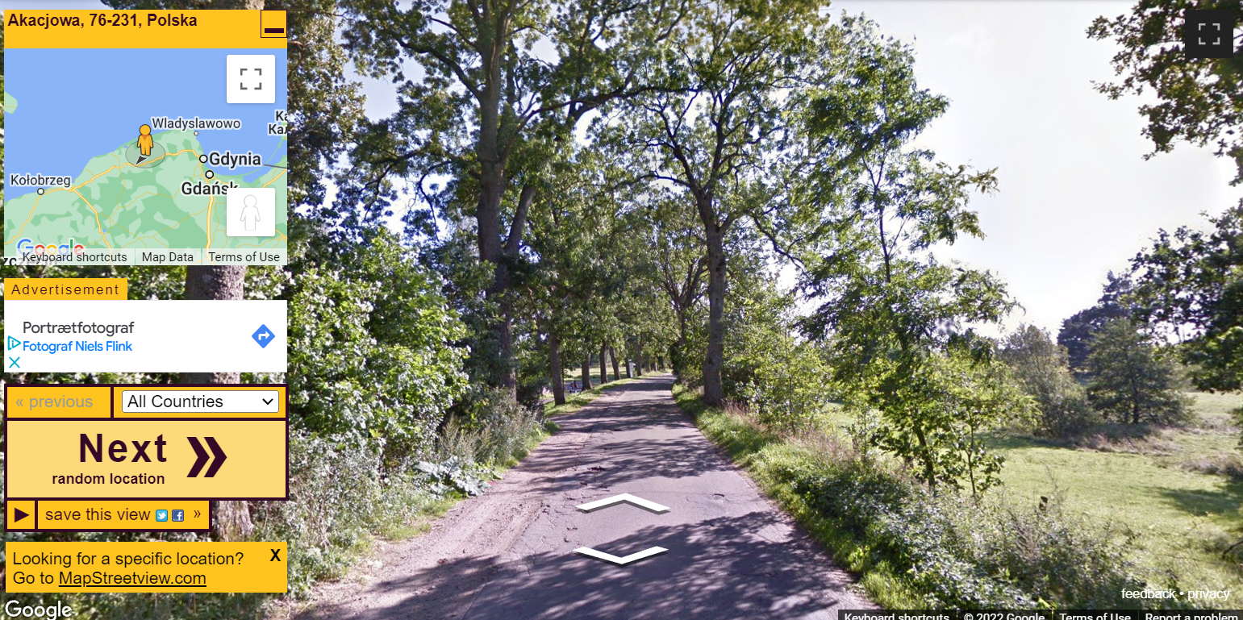
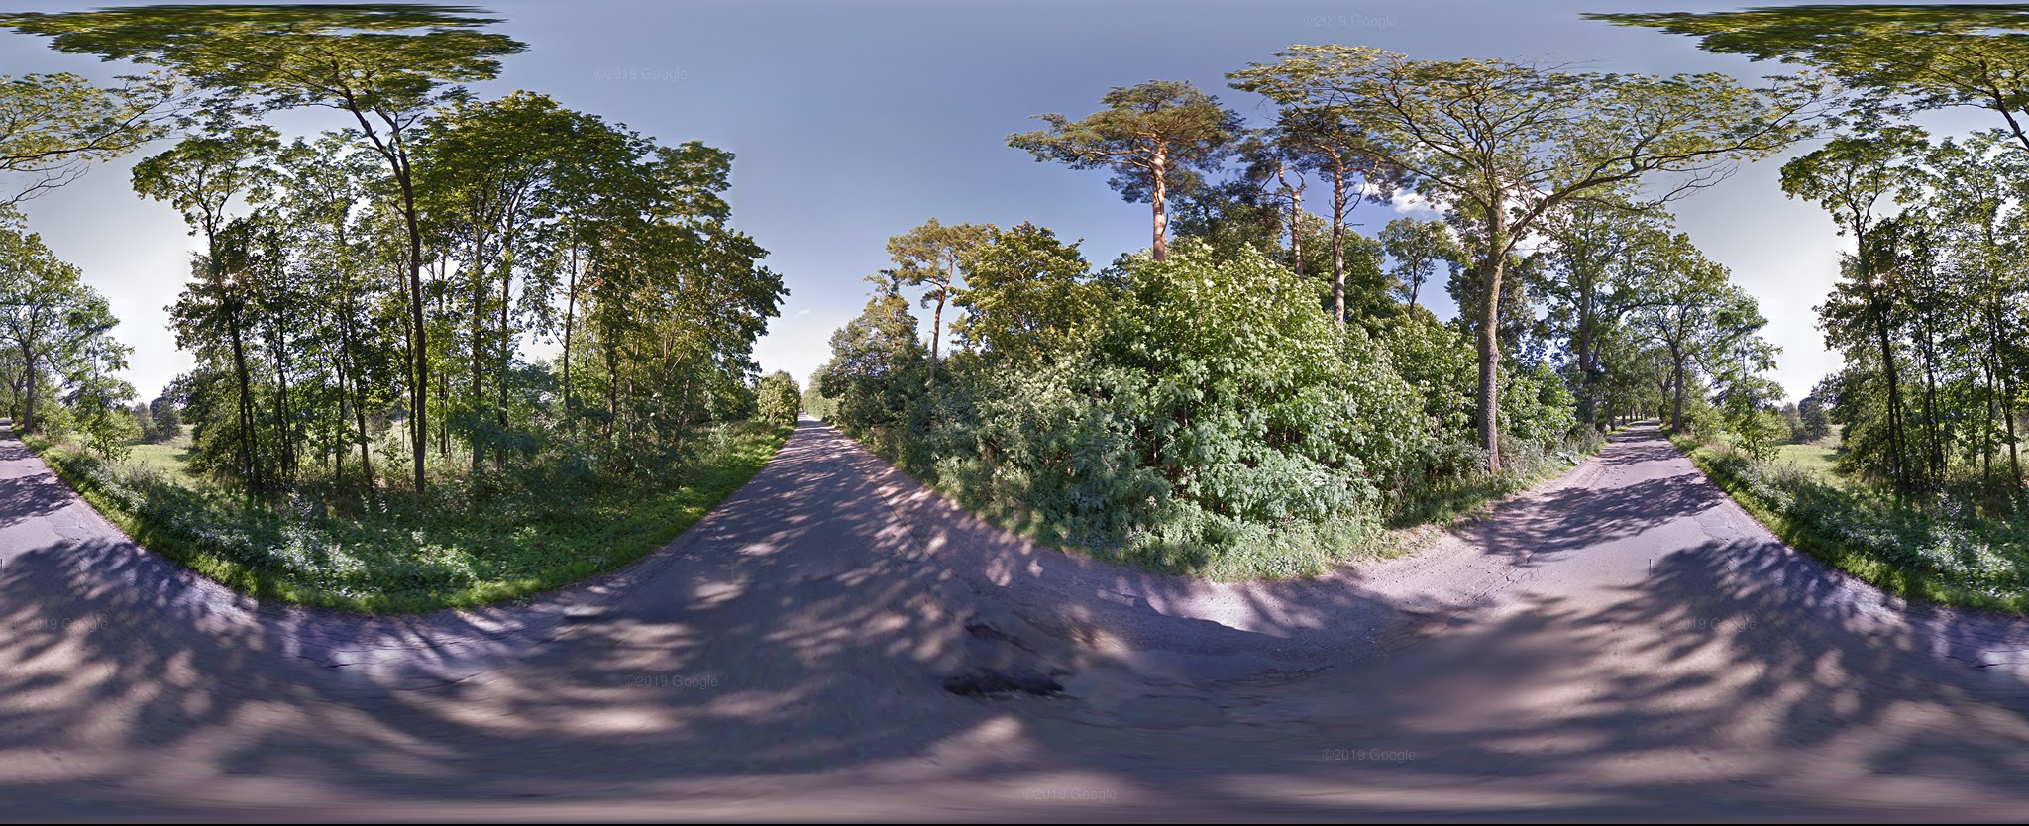
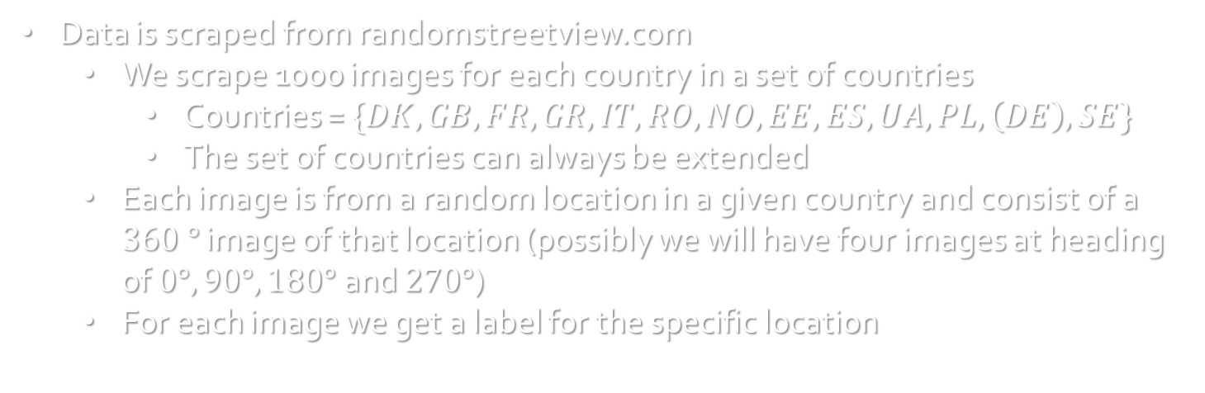
Data
Data is scraped from randomstreetview.com
We scrape 1000 images for each country in a set of countries
Countries = $\{DK, GB, FR, GR, IT, RO, NO, EE, ES, UA, PL, \left(DE\right), SE\}$
The set of countries can always be extended
Each image is from a random location in a given country and consist of a $360 °$ image of that location (possibly we will have four images at heading of $0°, 90°, 180°$ and $270°$)
For each image we get a label for the specific location

Slide 3
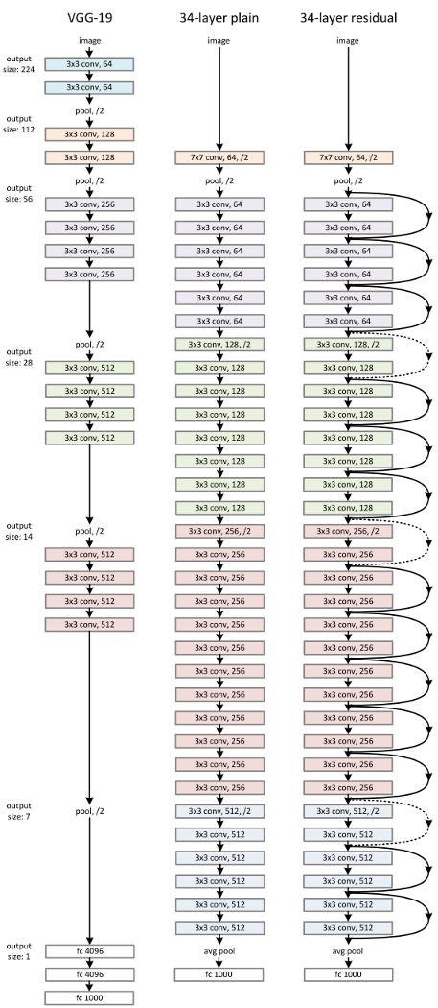


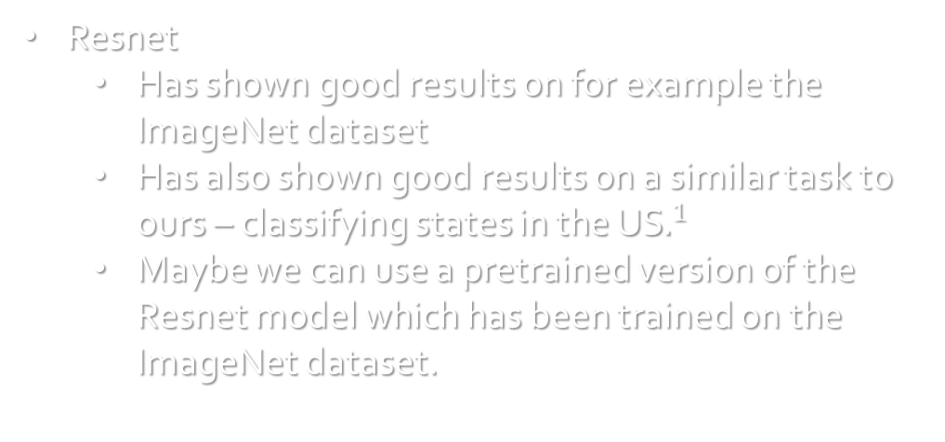
Model
Resnet
Has shown good results on for example the ImageNet dataset
Has also shown good results on a similar task to ours – classifying states in the US$.^{1}$
Maybe we can use a pretrained version of the Resnet model which has been trained on the ImageNet dataset.
$.^{1}$https://arxiv.org/pdf/1810.03077.pdf

Slide 4
Why is it interesting?
It will be fun to see how well a model performs compared to human intuition
Interesting to see how difficult it is for the model to differentiate between countries which are close one another (in terms of geographical features) compared to countries which are far apart.
Interesting to see how well a model can perform on a complex task as this

Slide 5
Training Approach and Obstacles
The training approach is rather simple – we just feed the model an image (or four image) along with a label indicating which country the image is taken in.
We could work with a combination of loss functions to capture the effect of both guessing the wrong country. And if the model makes a wrong guess, we can also look at how wrong it is in terms of distance to the correct country.
Cross Entropy Loss to capture if we make a wrong prediction
MSE to capture how far away the guess is from the correct country.
If the model performs poorly, we can also try to get more data.
We can also try to do some image augmentation.
If the model has a hard time distinguishing between similar countries, we can try to subset the set of countries which are more diverse

